Slide 1
JINI
ICS 237- Distributed Systems Middleware
Nalini Venkatasubramanian

Slide 2
Java RMI
Java communication
  Sockets
    pt-to-pt, duplex
    Pre-determined format, protocol
  RPC
    Abstract to procedure call
    Standard data representations
  RMI
    Object oriented RPC
    RPC+Java serialization to pack objects
3 processes
  Client
  Server
  RMI registry
Remote class must
  extendsRemote interface
  Server extends java.rmi.server.UnicastRemoteObject
rmic compiler
  stub and skeleton generation
Other Issues
  Serialization
  Exception handling
  Constructors

Slide 3
Java Serialization
Store and retrieve objects
  Capture enough state for reconstruction
  Generate a bytestream
Java interfaces for serialization
  java.io.Serializable: default serialization mechanism
  java.io.Externalizable: custom serialization
  Serialize to file, serialize an entire class

Slide 4
Jini Motivation
Need a distributed system based on the idea of federating groups of users and the resources required by those users.
Need an open software architecture that enables the creation of network-centric solutions which are highly adaptive to change.
Middleware solution to build adaptive networks that are scalable, evolvable and flexible as typically required in dynamic computing environments.

Slide 5
Jini – Java Middleware
  Network extension of Java
    Users share services and resources over a network
    Easy access to resources anywhere on the network while allowing network location of the user to change
  Simplifying the task of building, maintaining, and altering a network of devices, software, and users
    Support true plug and play in LAN-based networked systems
    SOHO (small office, home office environments)
    ROHO (remote office, home office environments)
  System of federated users and resources
    Appears to users as a single system
    A client/resource/service may belong to more than one Jini system at a time
Notes:
The Jini system extends the Java™ application environment from a single virtual machine to a network of machines. The Java application environment provides a good computing platform for distributed computing because both code and data can move from machine to machine. The environment has built-in security that allows the confidence to run code downloaded from another machine. Strong typing in the Java application environment enables identifying the class of an object to be run on a virtual machine even when the object did not originate on that machine. The result is a system in which the network supports a fluid configuration of objects which can move from place to place as needed and can call any part of the network to perform operations.

Slide 6
Environmental Assumptions
Existence of a network of “reasonable speed”
  Network latency is also “reasonable”
Connected devices have “some memory and processing power”
  Those that don’t must have a Jini proxy that does have memory and processing power
Needs the Java Environment
  Members are assumed to agree on basic notions of trust, administration, identification, and policy.
Notes:
The Jini system federates computers and computing devices into what appears to the user as a single system.
Any programming language can be supported by a Jini system if it has a compiler that produces compliant bytecodes for the Java programming language.

Slide 7
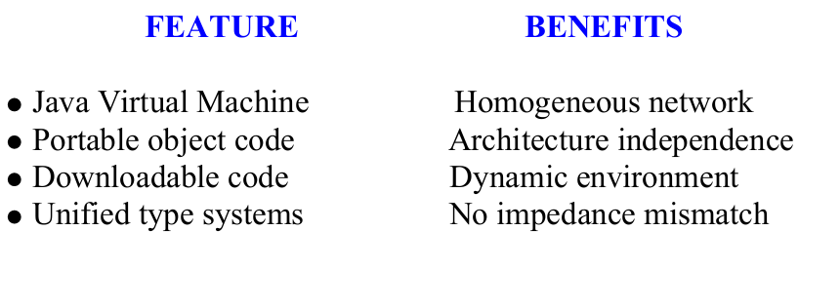
Jini Advantages

Slide 8
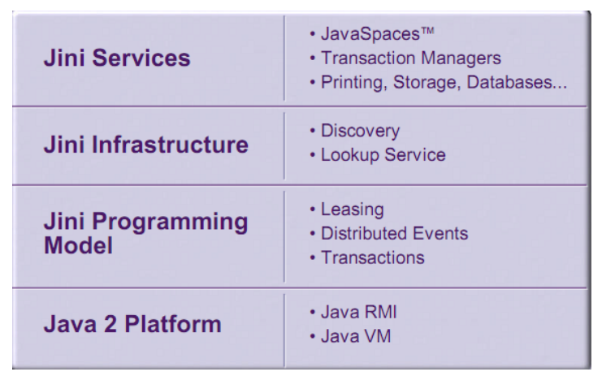
Jini Structure

Slide 9
Services
Anything that can be used in a Jini system
  Entity used by a person, program, another service, storage…
Utilized through a Service Protocol
  Set of interfaces written in Java
  Services carry the code needed to use them
  A small set of protocols is predefined
    e.g. Discovery, Join, Lookup
Communication happens through RMI
  Allows for objects and code to be sent around the network
Notes:
It is an entity that can be used by a person, a program, or another
service computation, storage.
It can be a communication channel to another user, a software
filter, a hardware device.
Examples: printing a document, translating from one word-processor to another
Jini is not a system consisting of client and servers. It is system
consisting of services that can be collected together for the
performance of a particular task.

Slide 10

What Jini is not
  Not just RMI
  Jini is not just a name server
  Jini is not a system consisting of client and servers. It is system consisting of services that can be collected together for the performance of a particular task.
  Jini is not JavaBeans
    JavaBeans provides a way for software components to find and introspect each other
    intended for use within a single address space
    less dynamic (design-time, not runtime)
  Jini is not EJB
    similar to Jini but intended to hook together legacy systems covered by Java wrappers to form the back-end business logic of enterprise applications
  Not a distributed OS

Slide 11
What Jini is
  Services carry the code needed to use them
    proxies are dynamically downloaded by clients when they need to use a service
  A “meta-service” provides access to all other services
    Lookup services keeps track of all other services in a community.
  Bootstrapping process to find proxies for the lookup service

Slide 12
Properties
Security: incorporates Java’s security models (sandboxing) --integrated into RMI
Service discovery and join: service protocols that allows services (both hardware and software) to discover, become part of, and advertise supplied services to the other members of the federation
Lookup: from a service repository Entries are downloadable Java objects that act as local proxies to the real service

Slide 13
Jini Overview
Service
Service
Lookup Service
Service
Lookup Service
Service
Client
Lookup Service
Service
Service
Jini group: cs237.uci.edu
Jini group: public

Slide 14
Jini Lookup Service
Core/ Central bootstrapping mechanism for the system
  provides the major point of contact between the system and users of the system.
Maps interfaces to objects that implement those interfaces
  Interface only describes functionality of a service
  Descriptive entries can be associated with a service to allow more flexible searching
Services can appear/disappear in a lightweight way
  A service is added to a lookup service by a pair of protocols called Discovery and Join.
  The service locates an appropriate lookup service using the discovery protocol.
  The service is added using the join protocol.

Slide 15
Lookup Service
Service item
Attribute
Proxy
Attribute
Service item
Attribute
Attribute
Proxy
Attribute
Service item
Attribute
Attribute
Proxy
Attribute
Attribute

Slide 16
Lookup Service
Jini Lookup Service is an interface
  Implementations can incorporate other lookup services
    Hierarchical Lookup
    Bridge between lookup services
Discover, Join and Lookup Protocols
  Discover to find a lookup service
  Join to add to the lookup service
  Lookup to find a service and use it

Slide 17
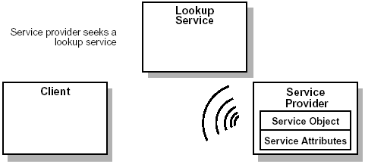
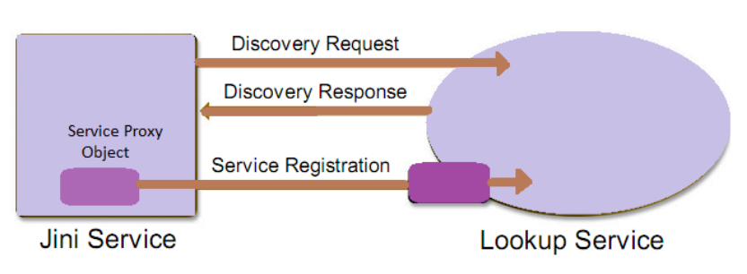
Jini Service Discovery

Slide 18
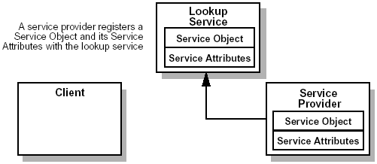
Jini
Join & Lookup Protocols
Join

Slide 19
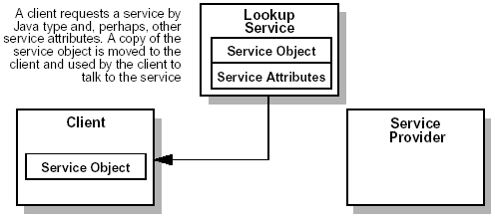
Discovery, Join & Lookup Protocols
Lookup

Slide 20
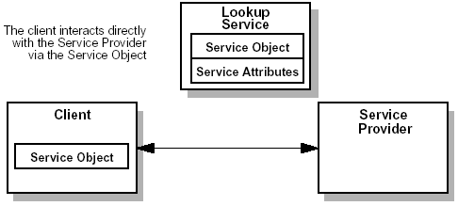
Discovery, Join & Lookup Protocols
Invocation

Slide 21
Attributes in Jini
  Attributes are Java objects
    assigned to service proxies
  Attributes describe service
    rich and flexible way for services to annotate their proxies with information describing that service
  Attribute matching
    set of rules to determine when attributes match one another
  template matching
    for matching against multiple attributes

Slide 22
Discovery Protocol
Happens when a device is first connected to the Jini System
  Used so a device could find/join multiple groups
The Unicast Discovery
  For applications and services that know about particular lookup services.
Multicast Request
  Device looking for Lookup Service in a group
Multicast Announce
  Lookup Service Advertises its presence

Slide 23
Discovery Protocol in Jini
Serendipitous discovery
  Jini allows serendipitous interactions between services and users of those services
  Service initiated discovery
    used when a service starts to find all lookup services in its vicinity
  Lookup service initiated discovery
    used when a lookup service starts and announces its presence to Jini services
Hardwired (Direct discovery)
  hardwire a Jini service to a lookup service

Slide 24
Discovery uses Multicast
Uses IP multicast based on UDP/IP
each message has a scope (distance) associated with it.
  Mcast address used for one set of hosts invisible to another set using same mcast address
  promotes efficiency in routing
  set IP TTL (how many hops) parameter

Slide 25
Discovery: An Example
Request
Lookup Service
other Group
Discovering Entity
Connects and Registers the Lookup Service with the entity
Request
Request
Lookup Service
public Group
Lookup Service
public Group
Muticast Request for Group: public

Slide 26
Join Protocol
Registers a service with a Lookup Service in a Jini System
  Each Service has a list of properties, Service ID, Attributes, a list of groups to register with, etc.
Uses Discovery to find Lookup Services
  Maintains a list of Lookup Services to register with
  Registers with all Lookup Service that responds
  Creates a lease during registration, which is renewed periodically

Slide 27
Lookup Protocol
Client queries the Lookup Service
  Find a service by name, or attributes
  Receive a copy of the service interface onto the client
Client interacts with service through this “proxy” object
  Client also gets a lease on the service

Slide 28
Join and Lookup: An Example
Lookup Service
Service Object
Service Attributes
Client
Service
Lookup
Join
Service Object
Service Object
Client uses Service
Service Attributes
Join: Service object is registered.
  Copy sent to reside on Lookup Service through RMI
Lookup: Service is copied to Client
  Service Object acts a proxy

Slide 29
Service Architecture
The service object on the client communicates with Service by:
  RMI
  Local implementation
  Combination of the above (smart proxy)
From client point of view:
  Services look the same across the network or in local address space
  All services are Java objects

Slide 30
Security
Based on principals and access contol lists
  Services accessed on behalf of some entity- the principal
    Usually traces back to the user
  Access is determined through an ACL associated with an object

Slide 31
Programming Model
The leasing interface
  defines a way of allocating and freeing resources using a renewable, duration-based model
The event and notification interface
  an extension of the event model used by JavaBeans™ components to the distributed environment that enables event-based communication between Jini services
Transaction interfaces
  enable entities to cooperate in such a way that either all of the changes made to the group occur atomically or none of them occur
  Jini provides an interface for two-phase commit transactions
    Does not provide implementation
    Does not define semantics of transactions
    Only provides protocol to coordinate
Notes:
Leasing
The lease interface extends the Java programming language model by adding time to the notion of holding a reference to a resource, enabling references to be reclaimed safely in the face of network failures.
Event
The event and notification interfaces extend the standard event models used by JavaBeans components and the Java application environment to the distributed case, enabling events to be handled by third-party objects while making various delivery and timeliness guarantees. The model also recognizes that the delivery of a distributed notification may be delayed.
Transaction
The transaction interfaces introduce a light-weight, object-oriented protocol enabling Jini applications to coordinate state changes.

Slide 32
Transactions in Jini
Create a transaction
  Jini transactionFactory object to create a transaction object to hold grouped operations
pass to it all the transactions to be grouped
tell to try to execute all operations atomically, which will either succeed or fail
  commit() call

Slide 33
Jini Events
Allows an object in one JVM to register for events occurring on another
  Possibly across a network
  Can register for different kinds of events
  Can schedule notifications
Provides interfaces that implement a protocol
  No guarantees made interfaces, only by implementations

Slide 34
Leasing
Set of interfaces that allow time-based resource allocation
  Guarantees access to a service while lease is in effect
  Can be renewed (depends in the service)
  Can be exclusive or non-exclusive
  Lease can be cancelled or it automatically expires at the end of the terms of the lease

Slide 35
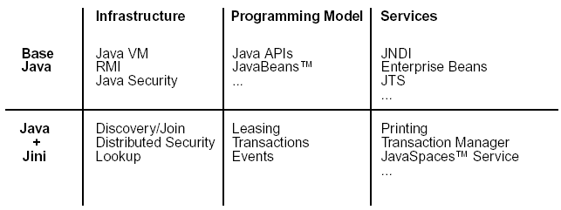
Component Overview

Slide 36
JINI summary
Federate devices and software components into a single, dynamic distributed system
Service: an entity that can be used by a person, a program, or another service
Lookup Service: discovery, join, lookup
RMI: Remote Method Invocation
Security: principal, access control list
Leasing: a grant of guaranteed access over a time period
Transactions
Events
Notes:
Service:
Jini systems provide mechanisms for service construction, lookup, communication, and use in a distributed system.
Services in a Jini system communicate with each other by using a service protocol, which is a set of interfaces written in the Java programming language.
Security:
Jini services are accessed on behalf of some entity—the principal—which generally traces back to a particular user of the system.
Leasing:
Access to many of the services in the Jini system environment is lease based. Leases are either exclusive or non-exclusive.

